Slide 1

THE FRONT END - HTML
Hyper Text Markup Language.

Slide 2
So, what does a website basically means?
It is a collection of web pages & content related to it that is identified by a common domain name and published on at least one web server available around us.
Generally, a website is divided into 2 branches.
Front-End
Back-End
Both the branches function simultaneously but are quite different from each other. Each side needs to communicate & operate effectively with the other as a single unit to improve the website's experience and functionality.

Slide 3
FRONT END.
This is the part of a website that the user interacts with directly. It is also referred to as the 'client-side' of the application.
Primarily the interface that a user experience while working on it.
There are variety of options to structure this out, some of them are HTML, CSS, JS, wherein HTML is dedicated as the body of the website while CSS is used in styling & making the website presentable.
Responsiveness & performance are the two main objectives of the Front-end.

Slide 4
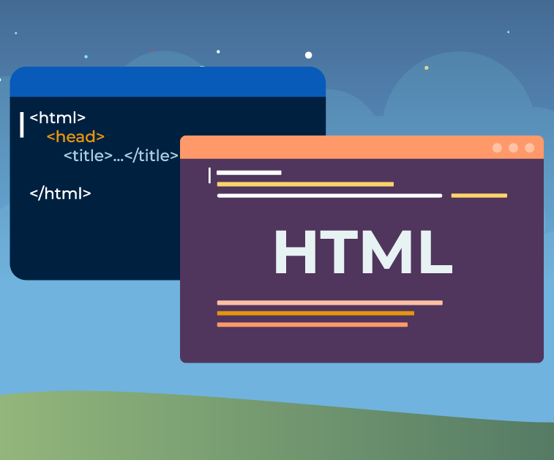
What is HTML ?
HTML is a markup language that defines the structure of your content.
It is used to make webpages. Webpages can include writing, links, pictures, and even sound, videos, etc.
HTML tells web browsers what webpages should look like.

Slide 5
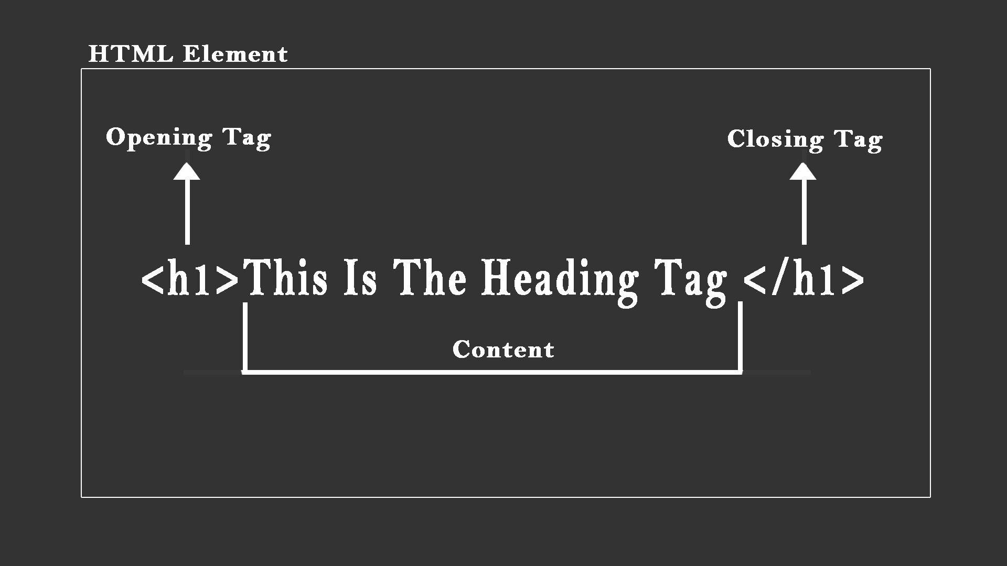
Structure of a primary HTML element

Slide 6
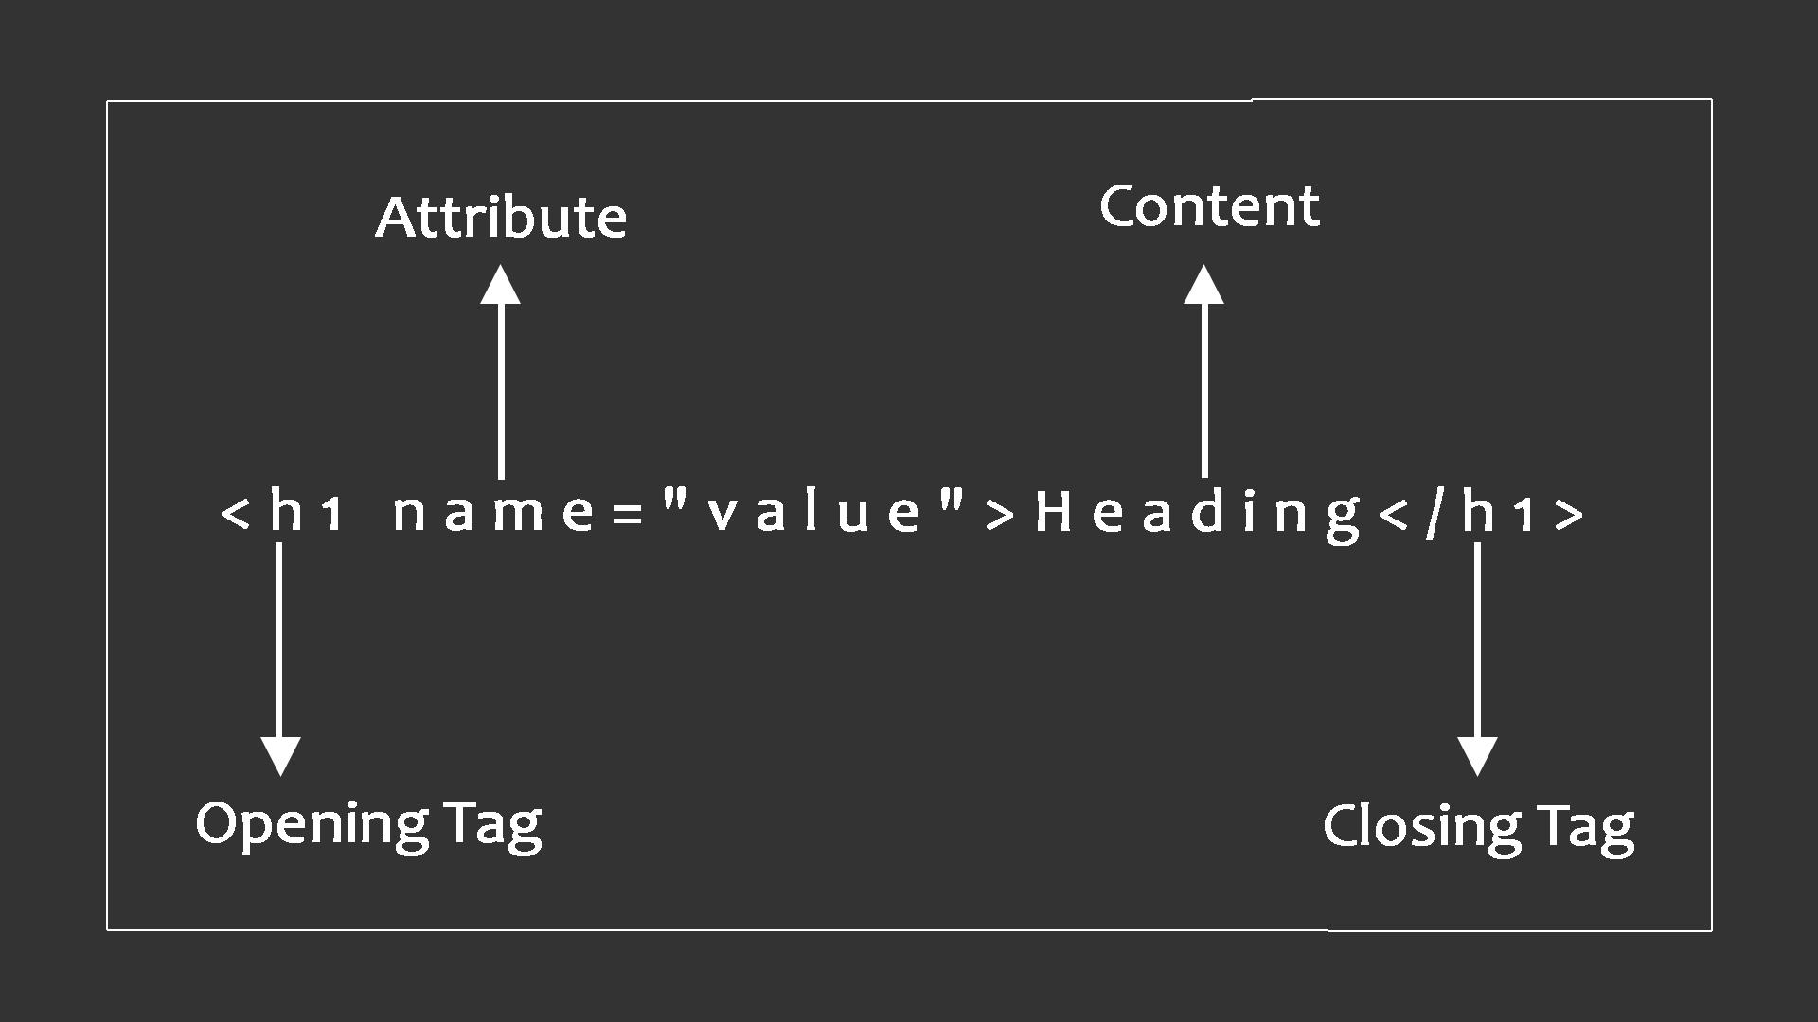
HTML Attributes.

Slide 7
Overview of today’s sess.
Attributes & Elements.
Tables, Lists,
How to apply headings, para’s & titles.
Classification of div, class, id, section, etc.
Form & its input types – label, type, value,
name, radio, color, range, etc
Comments , nav & much more.

Slide 8

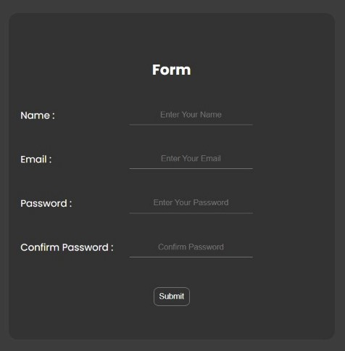
Final Outputs :

Slide 9

Our Upcoming Event

Slide 10
THANK YOU !

